Slide 1
Looping
Dr. Nachiket Tapas

Slide 2
Looping
Executing a pair of statements again and again
We have seen in the previous chapter that it is possible to execute a segment of a program repeatedly by introducing a counter and later testing it using the if statement.

Slide 3
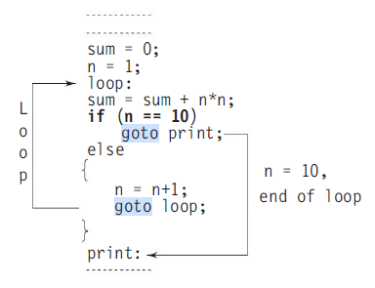
Sum of series: 1^2 + 2^2 + 3^2 + … + 9^2 + 10^2

Slide 4
Program Explanation
This program does the following things:
1. Initializes the variable n.
2. Computes the square of n and adds it to sum.
3. Tests the value of n to see whether it is equal to 10 or not. If it is equal to 10, then the program prints the results.
4. If n is less than 10, then it is incremented by one and the control goes back to compute the sum again.

Slide 5
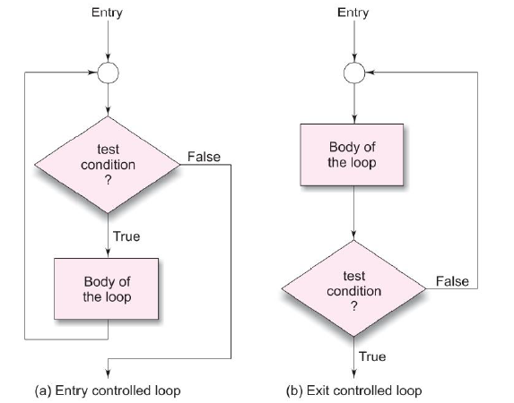
Types

Slide 6
Looping process
1. Setting and initialization of a condition variable.
2. Execution of the statements in the loop.
3. Test for a specified value of the condition variable for execution of the loop.
4. Incrementing or updating the condition variable.

Slide 7
Types
The while statement
The for statement
The do statement

Slide 8
Type based on termination condition
Counter-controlled loops (finite loops)
Based on the value of the variable
Sentinel-controlled loops (infinite loops)
Based on some special value like -1 or 999

Slide 9
While Loop/Statement
Also known as entry-control loop.
Syntax
while (test condition)
{
body of the loop
}
statement

Slide 10
Sum of series: 1^2 + 2^2 + 3^2 + … + 9^2 + 10^2
sum = 0;
n = 1; /* Initialization */
while(n <= 10) /* Testing */
{
sum = sum + n * n;
n = n+1; /* Incrementing */
}
printf(“sum = %d\n”, sum);

Slide 11
Do While Loop/Statement
Also known as exit-control loop.
Syntax
do
{
body of the loop
}
while (test-condition);

Slide 12
Sum of series: 1^2 + 2^2 + 3^2 + … + 9^2
sum = 0;
n = 1; /* Initialization */
do
{
sum = sum + n * n;
n = n+1; /* Incrementing */
} while(n < 10) /* Testing */
printf(“sum = %d\n”, sum);

Slide 13
FOR loop
Entry controlled loop.
Initialization of the control variable (ex. i = 1)
The value of the control variable is tested using the test-condition.
After the execution of the body, the control goes back to execute the increment statement.
Syntax
for ( initialization(1); test-condition(2); increment(3) ) {
body of the loop
}

Slide 14
Example
#include<stdio.h>
void main() {
int x;
for ( x = 0; x <= 9; x = x + 1 ) {
printf(“%d\n”, x);
}
printf(“\n”);
}
0
1
2
3
…
9

Slide 15
Sum of series: 1^2 + 2^2 + 3^2 + … + 9^2
int sum = 0,n;
for ( n = 1; n < 10; n = n + 1)
{
sum = sum + n * n;
}
printf(“sum = %d\n”, sum);

Slide 16
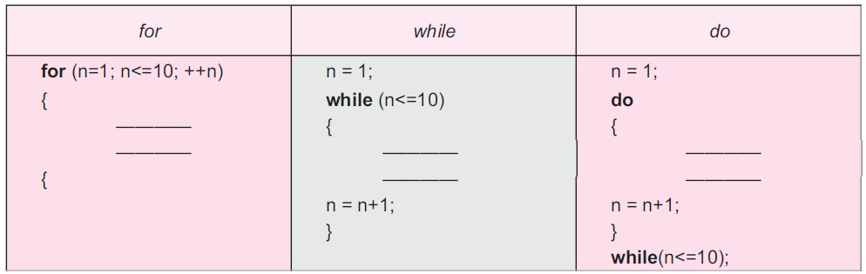
Comparison

Slide 17
Question
Using all three loops, write a C program to print all the prime numbers between 1 and n where ‘n’ is supplied by the user.
Using all three loops, write a C program to print the Fibonacci sequence.
0 1 1 2 3 5 8 13 21 …

Slide 18
Additional Features of For
Multiple initializations possible.
Multiple increment statements possible.
Compound test statements (condition_1 && condition_2) possible.
Elimination of one or all elements of for loop possible.

Slide 19
Nesting of Loops and its need
Nesting of loops is possible.
0
0 | 1
0 | 1 | 2
0 | 1 | 2 | 3
0 | 1 | 2 | 3 | 4
0 | 1 | 2 | 3 | 4 | 5
0 | 1 | 2 | 3 | 4 | 5 | 6
0 | 1 | 2 | 3 | 4 | 5 | 6 | 7

Slide 20
Jumps in Loops
Break
GoTo
Continue
for(;;) {
for(;;) {
if(x>12) break;
....
...
}
break;
}
statement x

Slide 21
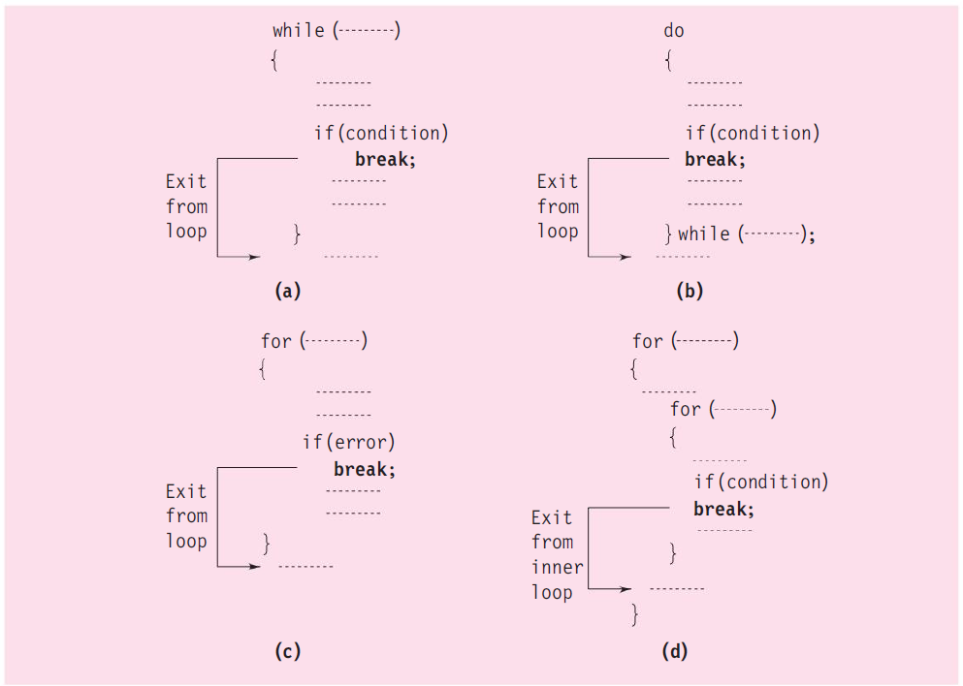
Break in Loop

Slide 22
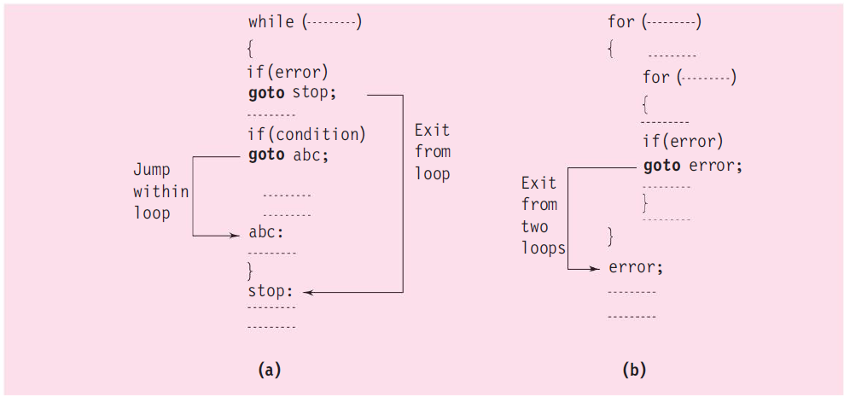
GoTo in Loop

Slide 23
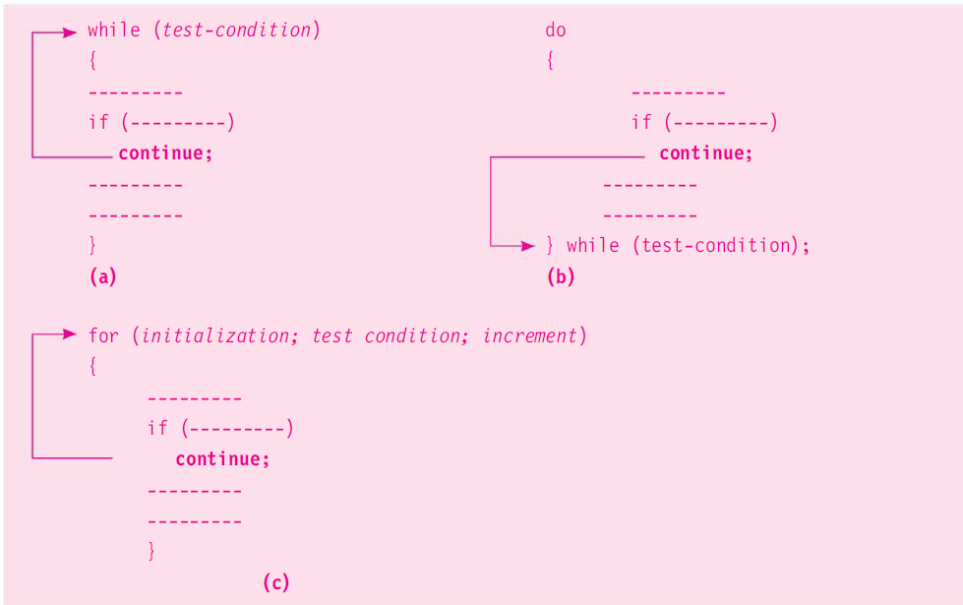
Continue in Loop

Slide 24
Jump out of program
exit(0)
we can jump out of a program by using the library function exit( ).
The exit( ) function takes an integer value as its argument.
Normally zero is used to indicate normal termination and a nonzero value to indicate termination due to some error or abnormal condition.
The use of exit( ) function requires the inclusion <stdlib.h>.
void main(){
....
exit(0);
printf(“Hello World”);
}

Slide 25
Usage
........
........
if (test-condition) exit(0) ;
........
........

Slide 26
Question
Write a C program to print the following pattern.
 |  |  |  |  |  |  | 0
 |  |  |  |  |  | 1 | 0 | 1
 |  |  |  |  | 2 | 1 | 0 | 1 | 2
 |  |  |  | 3 | 2 | 1 | 0 | 1 | 2 | 3
 |  |  | 4 | 3 | 2 | 1 | 0 | 1 | 2 | 3 | 4
 |  | 5 | 4 | 3 | 2 | 1 | 0 | 1 | 2 | 3 | 4 | 5
 | 6 | 5 | 4 | 3 | 2 | 1 | 0 | 1 | 2 | 3 | 4 | 5 | 6
7 | 6 | 5 | 4 | 3 | 2 | 1 | 0 | 1 | 2 | 3 | 4 | 5 | 6 | 7

